Slide 1
Housing Price Prediction
Gloria Shen, Junfeng Li, Yuehai Shen

Slide 2
Topic & Objectives
We are predicting the housing sales price in California. In order to improve the accuracy of our prediction, we will only focus on the house price for sale, and only includes the top cities with top 150 populations.
Combining different data including housing price data, cities demographics data, and neighborhood reviews data.

Slide 3
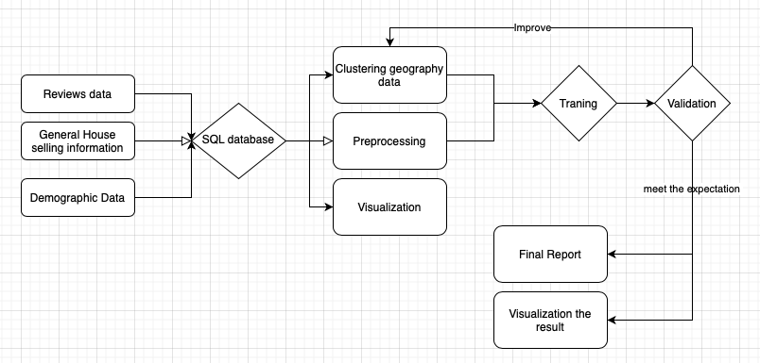
General Approach

Slide 4
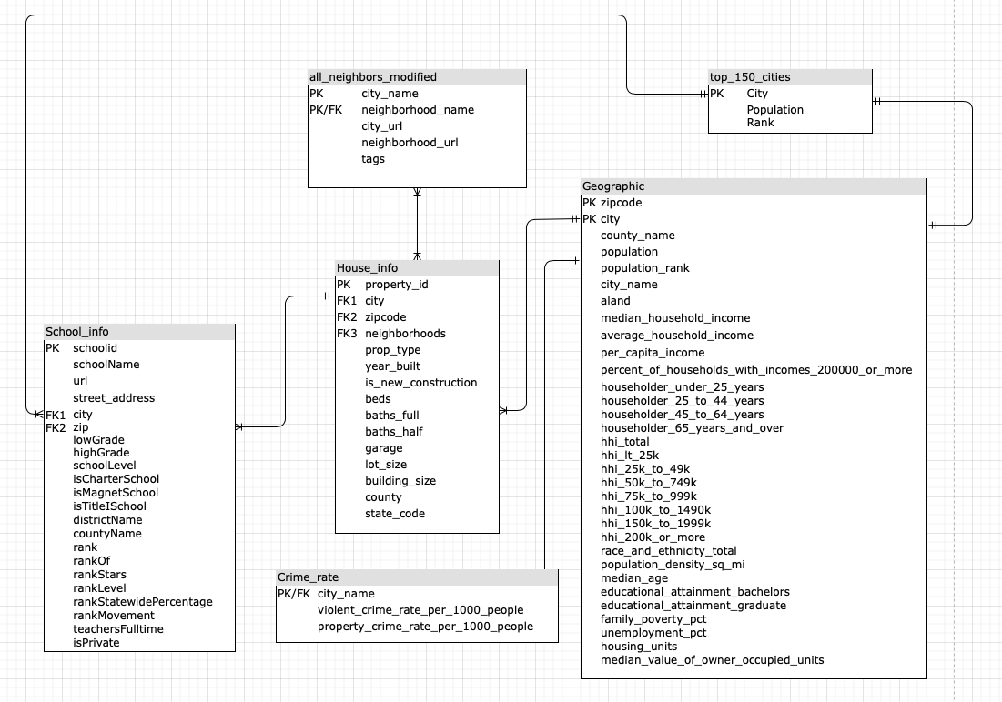
Datasets
- ER Diagram

Slide 5
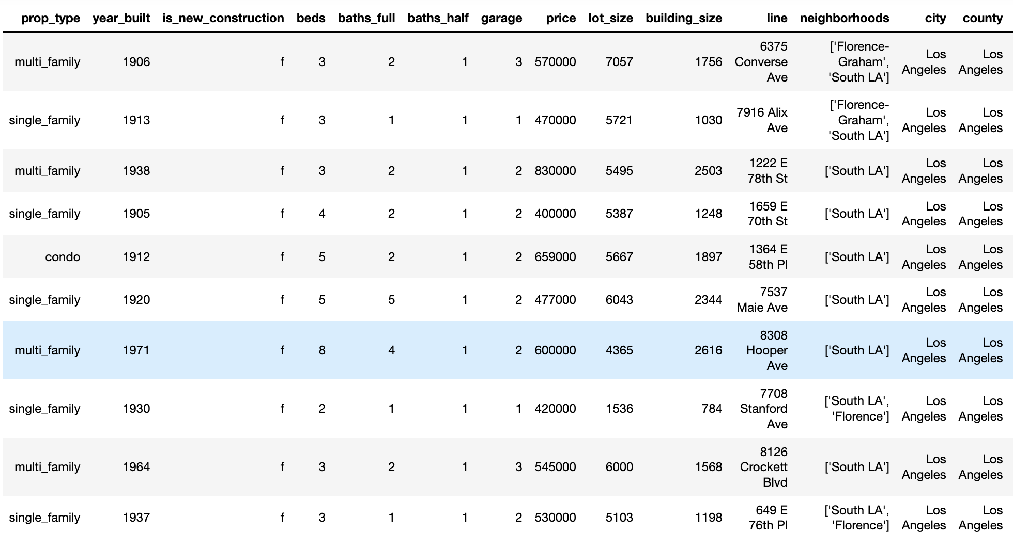
Datasets - General Housing Information
Data from Realtor API via rapidapi.com

Slide 6
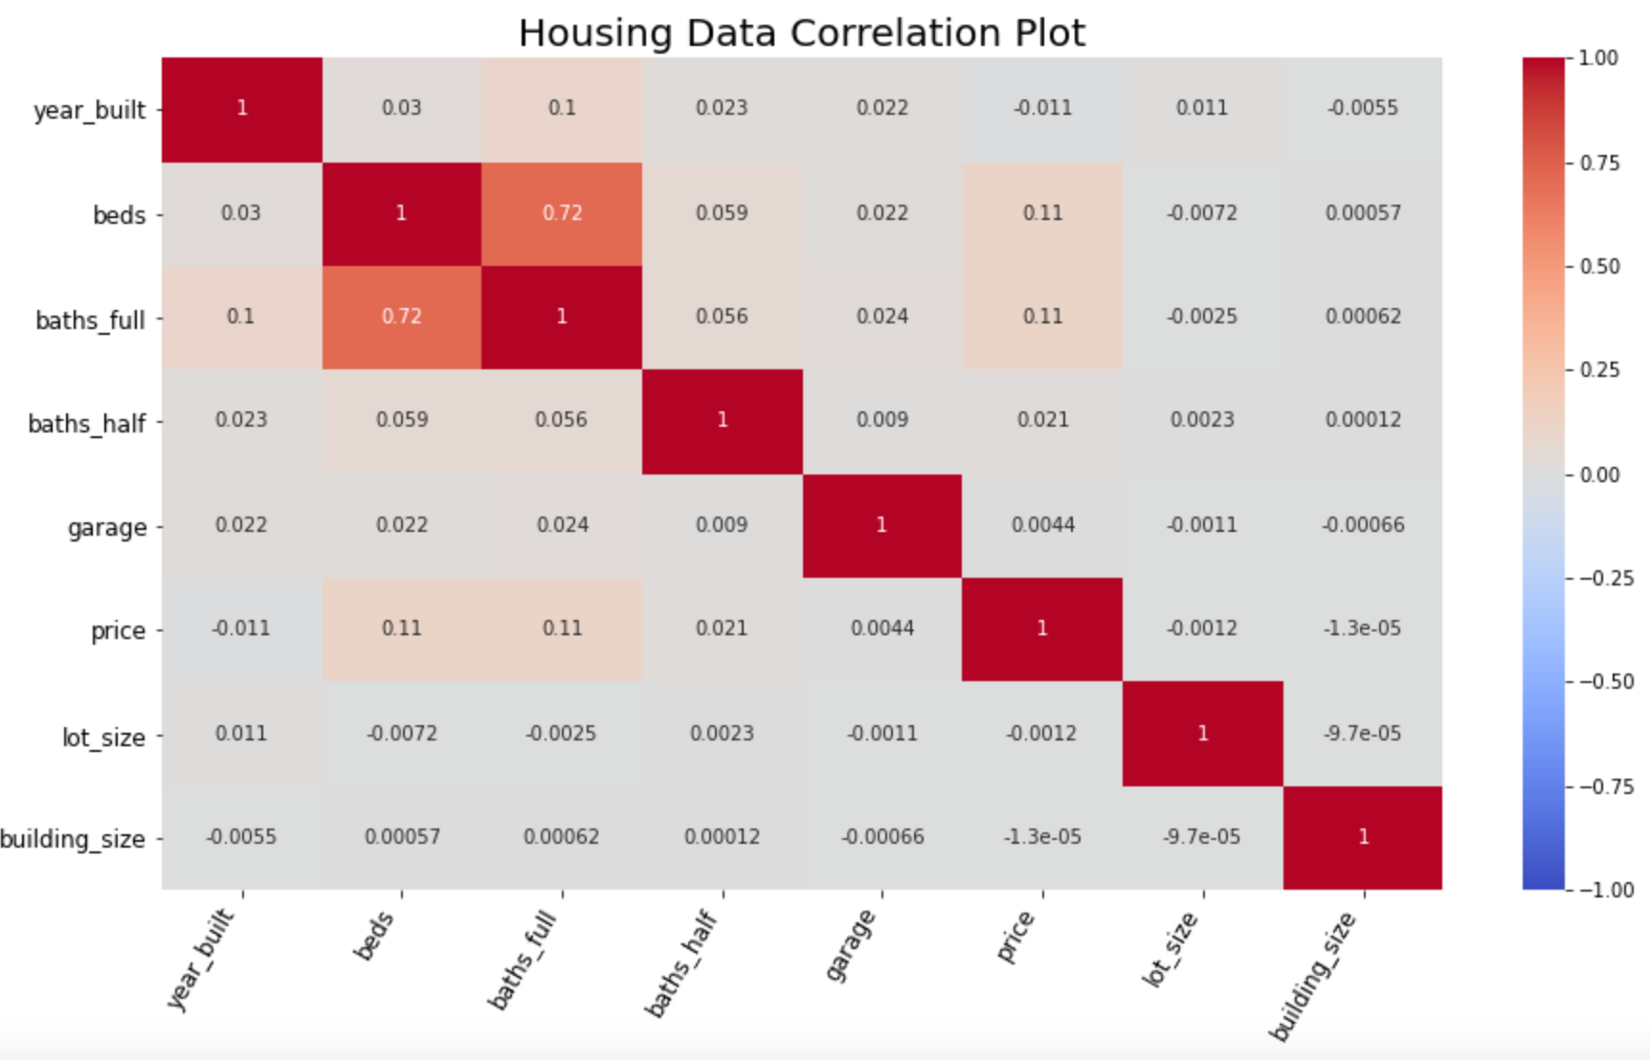
Housing Data Correlation Plot

Slide 7
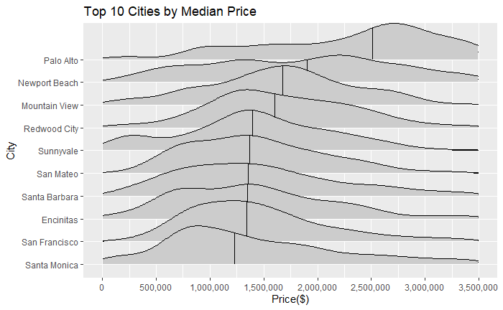
Top 10 Cities Sorted By Median Price

Slide 8
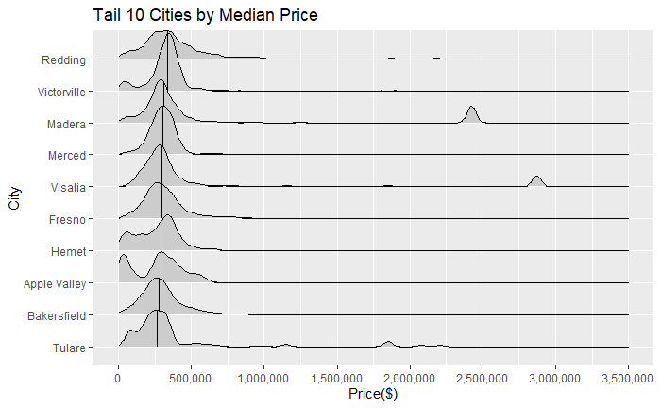
Tail 10 Cities Sorted By Median Price

Slide 9
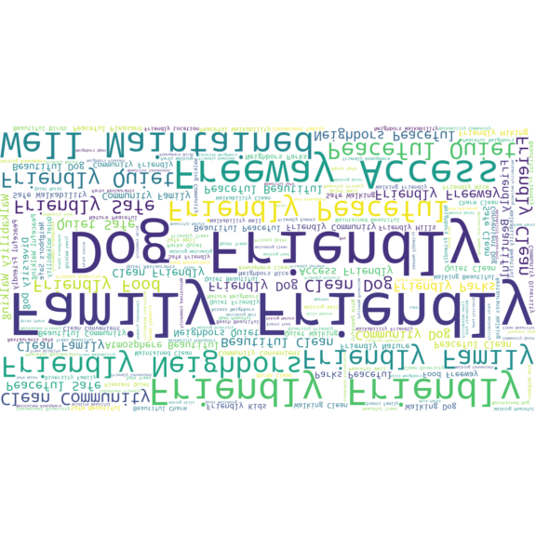
Neighborhood Data
Data from NextDoor.com

Slide 10
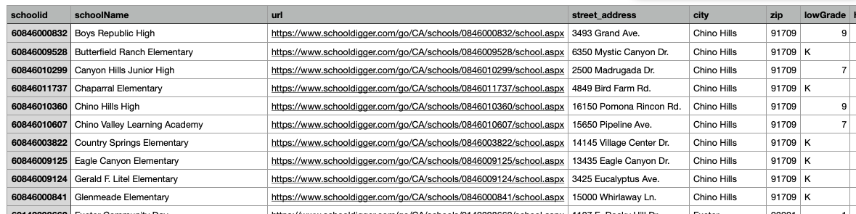
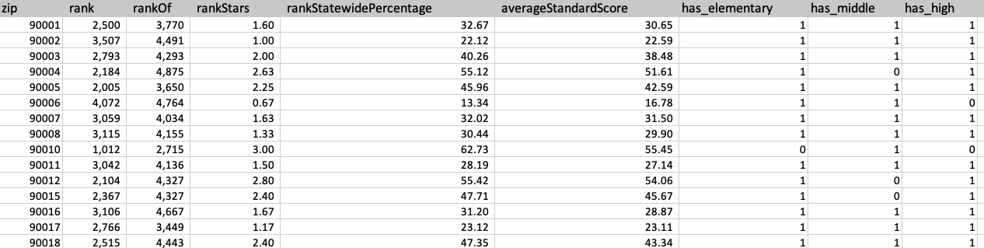
School Data
Data from SchoolDigger API

Slide 11
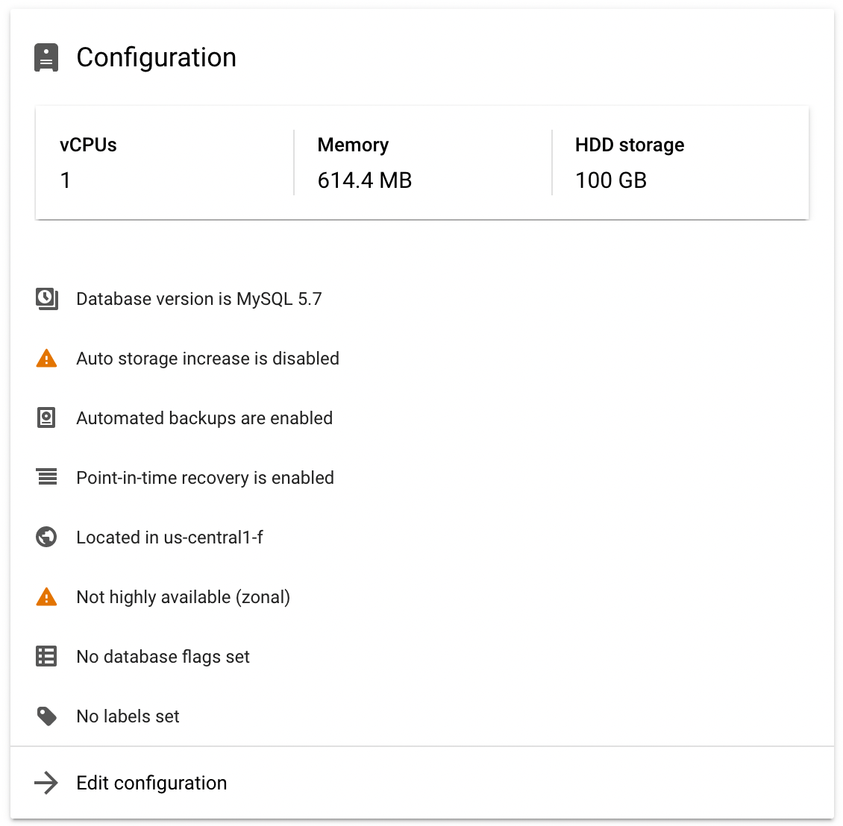
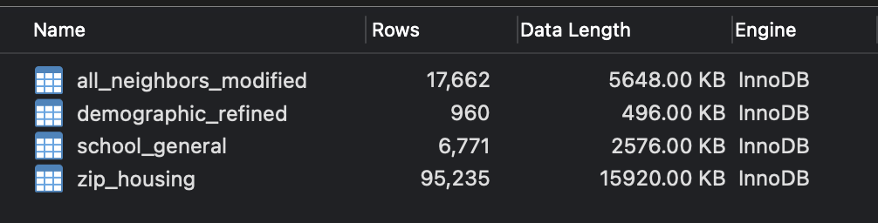
GCP Data Management

Slide 12
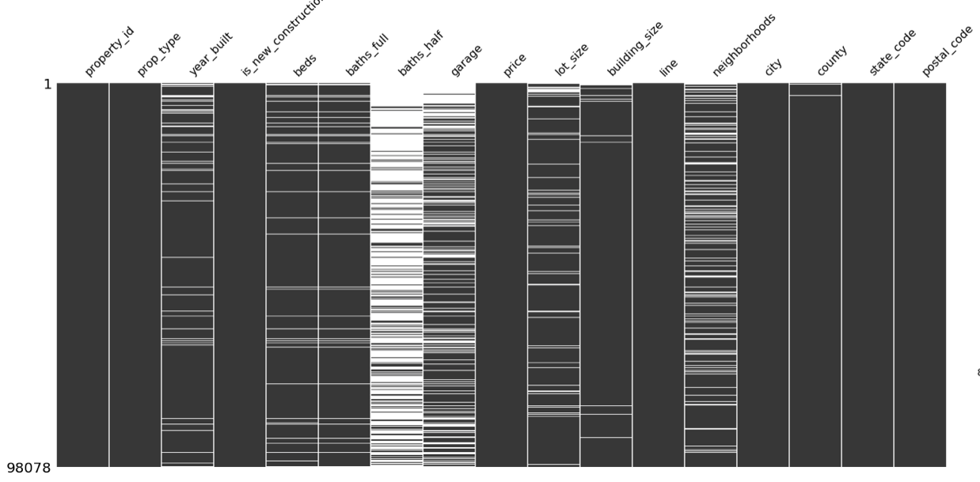
Preprocessing - Missing value

Slide 13
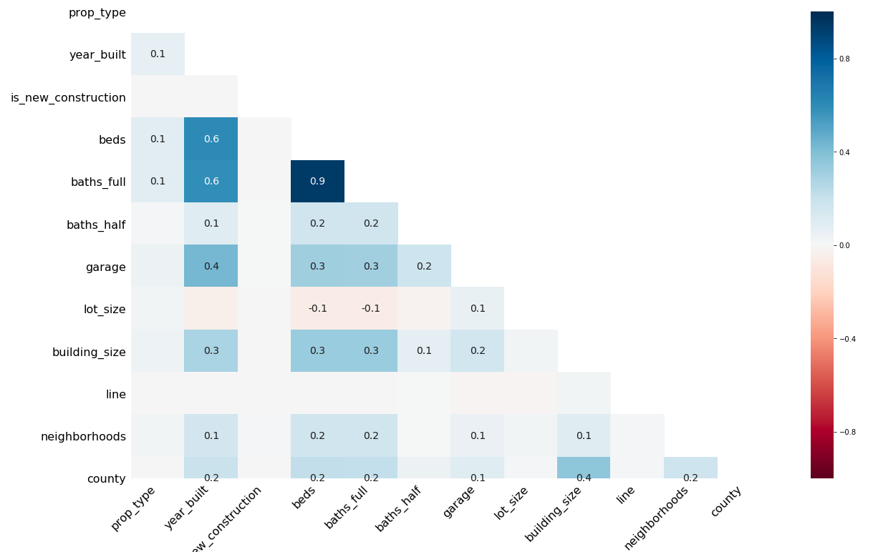
Preprocessing - Missing value

Slide 14
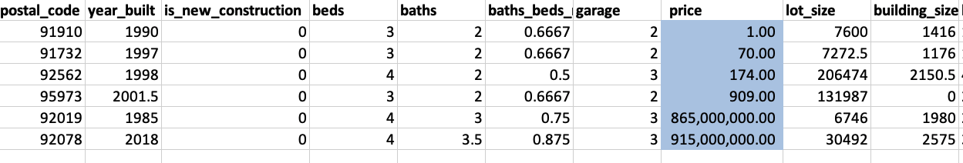
Data preprocessing - Outliers
By exploring the original data set, we find that several outlier with extremely high or low sale price comparing. In order to drop outlier in multiple-dimensional , we first tried DBSCAN* to tag the outliers and drop it, but we after we tried IQR** method, we think IQR can do the job better.
DBSCAN*: Density-based spatial clustering of applications with noise
IQR**: Interquartile Range

Slide 15
Stat/ML Methods - Overall Comparison
 | Linear Regression(w/o log) | KNN | Random Forest | Neural Network
Train RMSE | 372922.7 | 193244.24 | 115706.87 | 290807.38
Test RMSE | 388808.6 | 280420.61 | 200692.52 | 288347.53
Test Score(R-squared) | 0.64 | 0.8 | 0.89 | 0.79

Slide 16
Stat/ML Methods - Method 1: Linear Regression(Baseline)
A popular and commonly used method in different areas to solve regression problems
Adjusting coefficients for each predictor to get a linear model that having the least sum of squared error
Our data doesn’t have a huge amount of predictors
Linear regression is very efficient and may give out good result potentially

Slide 17
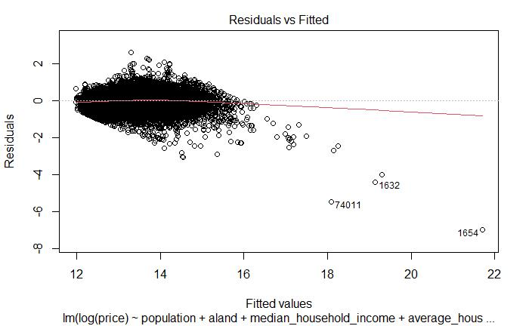
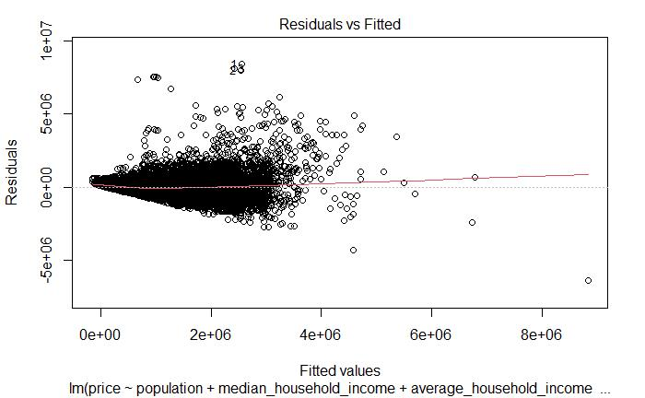
Stat/ML Methods - Method 1: Linear Regression(Baseline)
With log transformation
Without log transformation

Slide 18
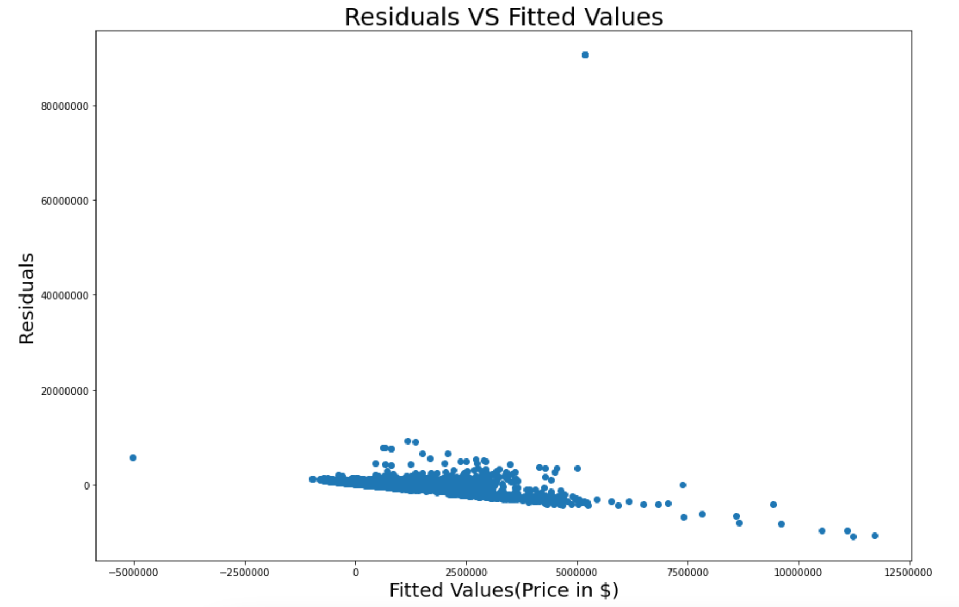
Stat/ML Methods - Method 1: Linear Regression(Baseline)
Mean R-Square = 0.078;
Train RMSE =2566798;
Test RMSE = 2823458;
No significant pattern;
Some huge residuals;

Slide 19
Stat/ML Methods - Method 2: KNN
Popular algorithm in Machine Learning
Finding nearest k(adjustable) samples around predicting point and calculating the samples’ mean as the predictive value of this point
More adjustable parameters than linear regression to find better result
Also efficient especially when k is relatively small

Slide 20
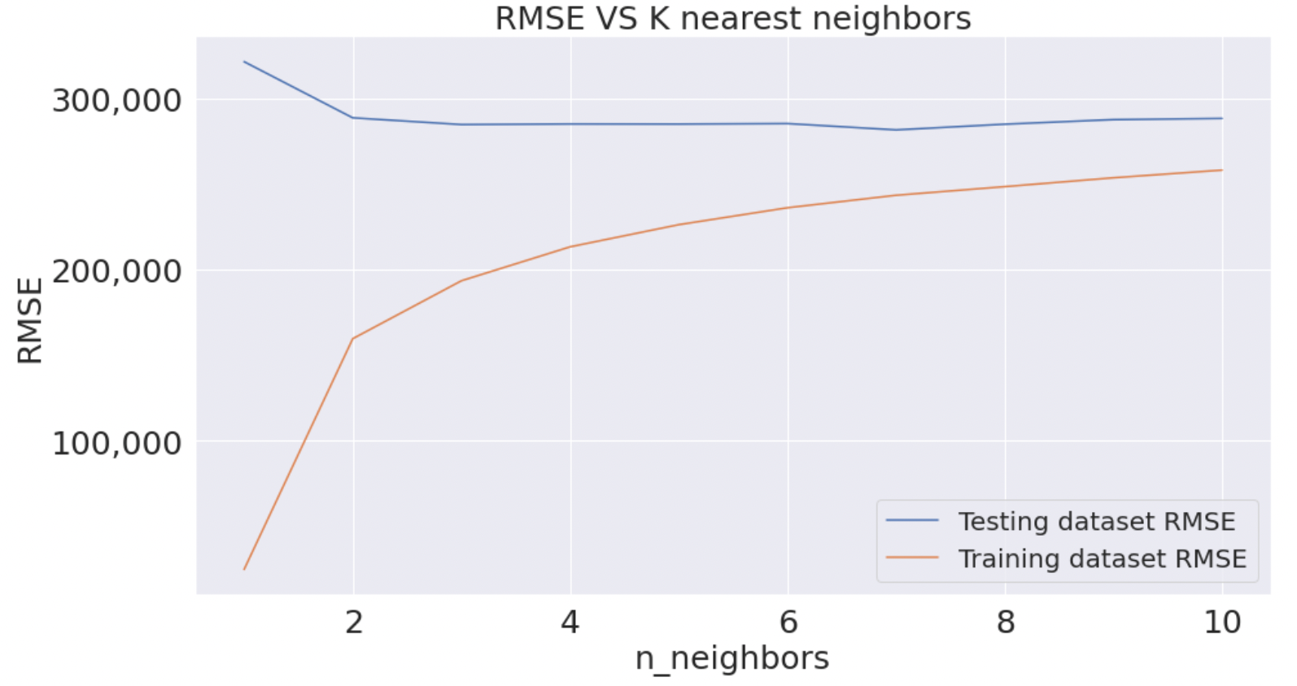
Stat/ML Methods - Method 2: KNN
Training RMSE(k=3): 193244.24
Testing RMSE(k=3): 280420.61
R-squared = 0.79

Slide 21
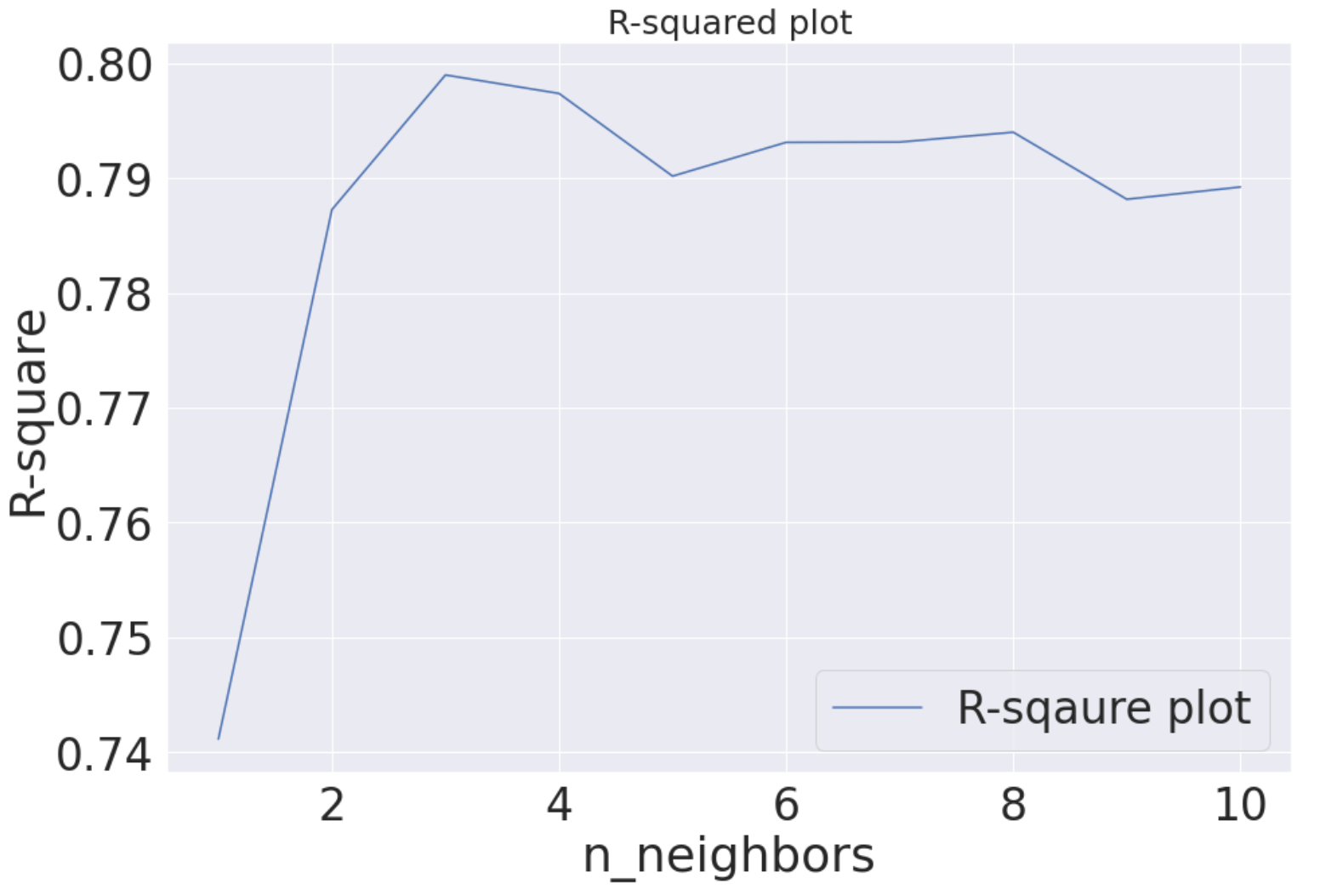
Stat/ML Methods - Method 2: KNN
Training RMSE(k=3): 193244.24
Testing RMSE(k=3): 280420.61
R-squared = 0.79

Slide 22
Stat/ML Methods - Method 2: KNN
The average distance between predictive values and real values is about 280 thousand dollar
Explain 80% of the variance in the data.
High score, and relatively low RMSE
Improved significantly after throwing out more outliers. (Testing RMSE: 1.08 million ->280 thousand)

Slide 23
Stat/ML Methods - Method 3: Random Forest
More parameters(n-estimators, max depth, max leaf nodes) to adjust
Contains multiple decision trees and output result based on vote from each of them
Research states random forest has better performance
Balance between efficiency and accuracy, very likely to be the best performance overall

Slide 24
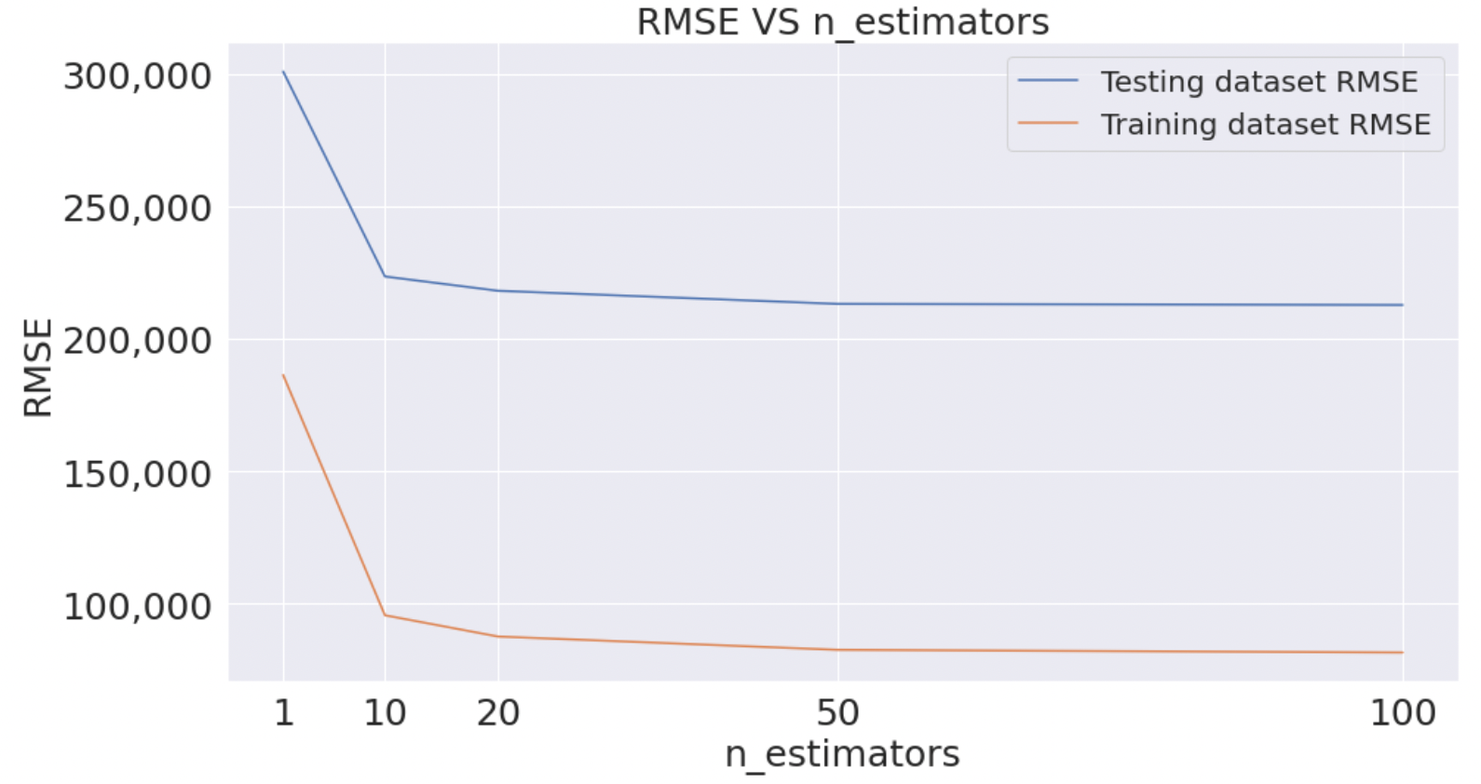
Stat/ML Methods - Method 3: Random Forest
Best n_estimators: 50
R-squared Score = 0.88
Training RMSE = 82421.07
Testing RMSE = 216218.56

Slide 25
Stat/ML Methods - Method 3: Random Forest
Random forest has the best performance at this stage
Some overfit, but still has the least test RMSE
No significant improvement at n = 100, so set to 50 for efficiency
High score, and low RMSE

Slide 26
Stat/ML Methods - Method 3: Random Forest
Adjust hyperparameters with RandomizedSearchCV with setting n_estimator to 50
Best out of 30 combinations of hyperparameters: bootstrap = True; max_depth = 80; min_samples_leaf = 2; min_samples_split = 5;
Result from this combination: Training error is 115706.87; Testing error for is 200692.52; R-squared: 0.89
This become the best model in this project

Slide 27
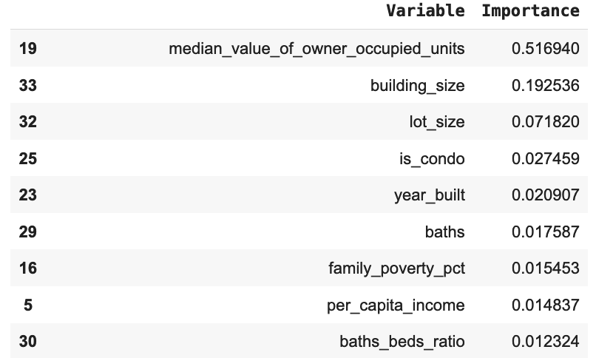
Stat/ML Methods - Method 3: Random Forest

Slide 28
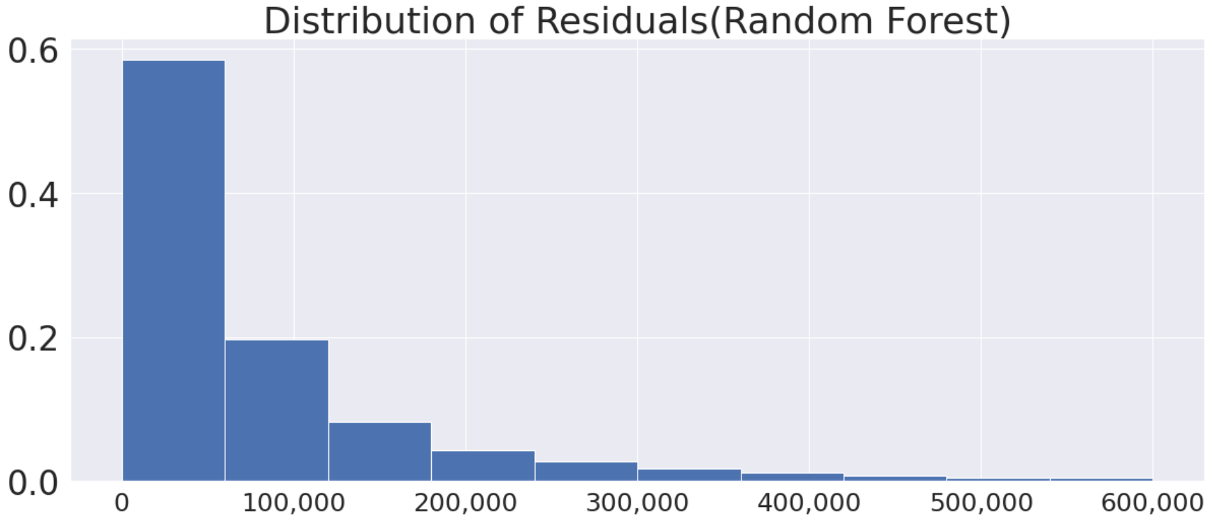
Conclusion
The average distance between predictive value and real value is about 200,000 dollars
It seems relatively large for house price(800,000 dollars), but we found that majority(about 80%) of the error is under 100,000
Absolute residuals
Percentage
Residual

Slide 29
What can we do better to improve the model?
Accidental outlier caused by sources
Still not precise regardless of outlier
Lack of specific detail about the houses, status of the seller, and current economy situation
Collect more information about these if have more time
Try more models like XGBoost

